Slide 1
CS102- Application of Information Communication Technologies
World Wide Web, Web vs. Desktop Apps, Mobile Apps

Slide 2
Applications
An application is a software that lets you exchange information with customers and help them complete specific tasks.
Different types of applications, or apps, are based on their development method and internal functionality.
4-<number>

Slide 3
Mobile Applications
A "mobile app" is a broad term that refers to any software application designed to run on mobile devices, such as smartphones and tablets.
These applications are developed to provide specific functionalities and services to users, ranging from productivity tools and entertainment to social networking and utility applications.
4-<number>

Slide 4
Desktop Applications
Desktop apps, short for desktop applications, are software applications designed to run on personal computers or desktop systems.
These applications are installed on the user's computer and are typically built to leverage the capabilities of the specific operating system (OS) on which they are intended to run.
Desktop apps operate as standalone software, providing users with a dedicated and often more robust user experience.
4-<number>

Slide 5
World Wide Web
The World Wide Web, commonly known as the WWW or simply the Web, is an information space where documents and other web resources are identified by Uniform Resource Locators (URLs) and can be accessed via the Internet.
This information can be in different formats, including text, images, audio, and video which can be viewed using browser software.
4-<number>

Slide 6
Key Components of www
Hyperlinks: Connect various web resources and enable navigation between web pages.
Web Browsers: Tools to navigate and access web content. Interpret and display web pages and provide a user interface for interaction i.e., Chrome, Firefox, Safari
Web Servers: Host and deliver web pages. Respond to user requests by serving web pages. It stores and manages website data.
4-<number>

Slide 7
Evolution of Web Usage
Static to Dynamic:
The early web primarily consisted of static pages displaying information.
Today, we've transitioned to a dynamic web where user interaction is crucial.
Changing User Expectations:
Users now expect more than just information, they seek interactive and personalized experiences.
4-<number>

Slide 8
Web applications
Web applications (web apps) are software applications that run on web browsers.
Web applications bring a new level of functionality, enabling users to interact, transact, and collaborate seamlessly.
Examples of web applications include social media platforms (e.g., Facebook, Twitter), email services (e.g., Gmail, Outlook), online collaboration tools (e.g., Google Docs), and e-commerce websites (e.g., Amazon, eBay).
4-<number>

Slide 9
Key characteristics of web applications
Key characteristics of web applications include:
Accessibility:
Accessible from any device with a compatible web browser.
Interactivity:
Enables dynamic features and active user engagement.
Data Storage:
Stores data on servers for universal access and collaboration.
Updates and Maintenance:
Centralized updates for constant access to the latest version.
Cross-Platform Compatibility:(Across different types of devices or OS)
Versatile and compatible across various devices and operating systems.
4-<number>

Slide 10
Development of web app
Web applications are typically built using web technologies such as HTML, CSS, and JavaScript for the front end, and various server-side languages (e.g., Python, Ruby, PHP) and databases for the backend. They rely on a client-server architecture, where the client (web browser) interacts with the server to retrieve and submit data.
4-<number>

Slide 11
Disadvantages of Web Applications
Dependence on Internet Connectivity
Performance Variability(internet speed and browser type)
Security Concerns
Browser Compatibility Issues
Limited Offline Functionality
4-<number>

Slide 12
Native Applications
Native apps are software applications specifically designed and developed for a particular platform or operating system (OS).
These apps are created using platform-specific programming languages and development frameworks. As a result, a native app for one operating system cannot run on another without modification.
Popular examples of native apps include Instagram, Snapchat, and WhatsApp for mobile devices.
4-<number>

Slide 13
Key Characteristics of Native Apps
Key characteristics of native apps include:
Platform-Specific Development:
Native apps are written in languages that are native to the platform. For example, Swift or Objective-C for iOS apps and Java or Kotlin for Android apps.
Optimized Performance:
Native apps typically offer high performance because they are optimized for the underlying hardware and software of the device.
Access to Device Features:
Developers have full access to the device's features and capabilities, such as camera, GPS, and sensors, allowing for advanced functionalities.
4-<number>

Slide 14
Key Characteristics of Native Apps
Native Look and Feel:
Native apps adhere to the design guidelines and user interface conventions of the platform, providing a consistent and familiar user experience.
App Store Distribution:
Native apps are distributed through platform-specific app stores, such as the Apple App Store for iOS or Google Play for Android.
Offline Functionality:
Native apps can offer robust offline functionality, allowing users to access certain features or content without an internet connection.
4-<number>

Slide 15
Development of Native app
Native app development involves crafting software applications tailored for specific operating systems, such as Swift or Objective-C for iOS and Java or Kotlin for Android.
Developers utilize platform-specific Integrated Development Environments (IDEs) like Xcode for iOS and Android Studio for Android.
The final step involves submitting the app to platform-specific app stores, like the Apple App Store and Google Play, for distribution.
4-<number>

Slide 16
Disadvantages of Native Apps
Platform-Specific Development
Distribution Challenges
Skill and Resource Intensive
Updates and Maintenance
Limited Cross-Platform Compatibility
Cost Considerations
App Store Approval Process
Dependence on App Store Policies
4-<number>

Slide 17
Hybrid Apps
Hybrid apps are software applications that combine elements of both native and web applications. These apps are developed using web technologies such as HTML, CSS, and JavaScript, similar to web apps. However, unlike purely web-based applications, hybrid apps are wrapped in a native container, allowing them to be installed and run on a device like a native app.
4-<number>

Slide 18
Key Characteristics of Hybrid Apps
Key characteristics of hybrid apps include:
Web Technologies: Hybrid apps are primarily built using web technologies, making them cross-platform and allowing developers to use a single codebase for multiple platforms.
Native Container: The web-based code is encapsulated within a native wrapper, providing access to device-specific features and enabling the app to be distributed through app stores.
Cross-Platform Compatibility: Hybrid apps aim to offer a consistent user experience across different platforms (iOS, Android, etc.) with a shared codebase.
4-<number>

Slide 19
Key Characteristics of Hybrid Apps
Access to Device Features: While hybrid apps may not have the same level of access to device features as fully native apps, they can leverage plugins or APIs to interact with certain hardware functionalities.
Development Efficiency: Hybrid app development is often considered more efficient than developing separate native apps for each platform, as it allows developers to write code once and deploy it on multiple platforms.
4-<number>

Slide 20
Development of Hybrid app
Examples of hybrid app development frameworks include Ionic, React Native, and Xamarin. These frameworks provide tools and libraries to streamline the development process and enhance the performance of hybrid apps. Hybrid apps are a popular choice for businesses seeking a cost-effective and time-efficient solution for building mobile applications that can run on various platforms.
4-<number>

Slide 21
Disadvantages of Hybrid Apps
Performance Limitations
Limited Access to Native Features
User Experience Challenges
Dependency on Third-Party Frameworks
App Store Approval Challenges
Offline Functionality Concerns
Learning Curve for Web Developers
Dependency on Web Views
4-<number>

Slide 22
How to chose right app?
Project Requirements
Target Audience
Development Time and Cost
Performance Needs
Cross-Platform Compatibility
Access to Device Features
Offline Functionality
App Store Approval Process
Development Team Expertise
Future Maintenance
4-<number>

Slide 23
Different types of applications
E-commerce applications
E-governance applications
E-Health applications
E-Education applications
4-<number>

Slide 24
E-commerce Applications
Commerce refers to exchanging goods, services, or commodities between individuals, businesses, or entities. It involves various activities related to the buying and selling products, typically to make a profit.
Traditional forms of commerce involve physical transactions, while modern commerce increasingly involves electronic and online transactions, known as e-commerce.
4-<number>

Slide 25
Key Features of E-Commerce Applications
E-Commerce, refers to the buying and selling of goods and services over the Internet. Key features involve:
Online Transactions: Enables buying and selling of products or services electronically.
Digital Payments: Facilitates secure online payment methods.
Electronic Data Exchange: Exchange of business documents and information in a digital format.
24/7 Accessibility: Provides round-the-clock accessibility for users.
Global Reach: Allows businesses to reach a global audience.
4-<number>

Slide 26
Success Stories in E-Commerce
Amazon: Global e-commerce giant offering a wide range of products.
eBay: Online auction and shopping website with a diverse marketplace.
Shopify: E-commerce platform for businesses to set up online stores.
Walmart.com: Multinational retail corporation with a significant online presence.
4-<number>

Slide 27
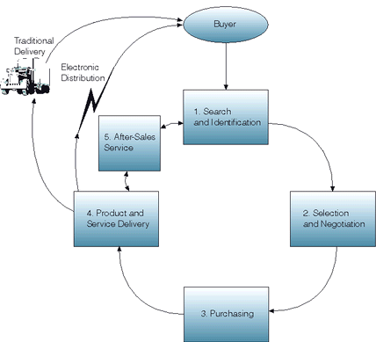
Multistage Model for E-commerce

Slide 28
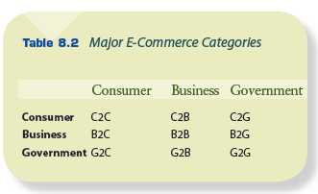
E-Commerce categories
4-<number>

Slide 29
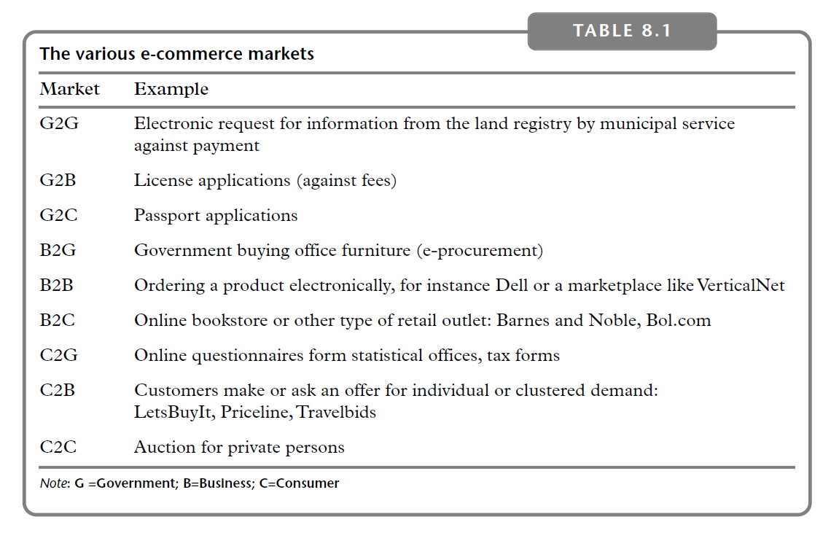
4-<number>

Slide 30
Business-to-Business E-Commerce
B2B E-Commerce involves online transactions between businesses, where products, services, or information are exchanged electronically.
Fastest growing segment of e-commerce
Example:
  Alibaba: Connecting businesses globally for wholesale transactions.
  ThomasNet: Platform for sourcing industrial products and services.

Slide 31
Business-to-Consumer E-Commerce
B2C E-Commerce refers to online transactions where businesses sell goods or services directly to end consumers through digital platforms.
Examples:
  Amazon: Global marketplace offering a vast array of products.
  Netflix: Subscription-based platform for streaming entertainment content.
  Zara Online: Fashion retailer providing online shopping options.

Slide 32
Consumer-to-Consumer E-Commerce
In C2C transactions, individual consumers sell directly to other individual consumers through online platforms or marketplaces. It includes online auction sites and peer-to-peer platforms that facilitate the buying and selling of goods and services among individuals.
Example:
  eBay: One of the earliest and most well-known C2C platforms, allowing individuals to auction and sell items to other users.
  Facebook Marketplace: A platform integrated into Facebook, allowing users to buy and sell items locally.
4-<number>

Slide 33
Consumer-to-Business E-Commerce
Involves people selling products or services to businesses
Example:
  Freelance Platforms: Websites like Upwork and Fiverr allow individuals to offer their skills and services to businesses seeking specific tasks or projects.
  Influencer Collaborations: Brands may engage with individual influencers for promotional activities, leveraging their audience and influence.

Slide 34
E-government applications
E-government applications refer to the use of information and communication technologies (ICTs) by government agencies to enhance the delivery of public services, improve efficiency, and promote transparency in governance.
These applications leverage digital technologies to streamline administrative processes, provide online services to citizens, and facilitate communication between government entities and the public.
4-<number>

Slide 35
Examples:
Online Service Portals: Web portals that allow citizens to access various government services online. Examples: Paying taxes, renewing licenses, applying for permits, and accessing government information.
E-Government Websites: Websites that serve as official platforms for government agencies to communicate information, updates, and resources to the public. Examples: Government department websites, official announcements, and policy updates.
Digital Identity and Authentication: Systems that enable citizens to establish and verify their digital identity for secure online interactions with government services. Examples: Digital IDs and authentication platforms for accessing government portals.
4-<number>

Slide 36
E-government applications
Categories:
  Government-to-citizen (G2C)
  Government-to-business (G2B)
  Government-to-government (G2G)
  Government-to-employee (G2E)

Slide 37
Government-to-Citizen (G2C)
G2C refers to interactions between government entities and individual citizens. It involves the delivery of public services, information, and resources directly to citizens.
Example: Online tax filing systems where citizens can submit their tax returns electronically, access government benefits, pay bills, and obtain official documents like passports and driver's licenses through government portals.
4-<number>

Slide 38
Government-to-Business (G2B)
G2B involves interactions between government agencies and businesses. It focuses on providing services and information to support businesses in their operations and compliance with regulations.
Example: Online business registration platforms where companies can register, renew licenses, submit regulatory compliance documents, and access information related to government procurement opportunities.
4-<number>

Slide 39
Government-to-Government (G2G)
G2G refers to interactions and collaborations between different government agencies or departments. It involves the exchange of information, services, and resources among government entities.
Example: A national health department sharing public health data and information with regional health agencies to coordinate responses to disease outbreaks or emergencies.
4-<number>

Slide 40
Government-to-Employee (G2E):
G2E involves interactions between government organizations and their employees. It focuses on providing services, information, and support to government personnel.
Example: An internal HR portal where government employees can access their payroll information, submit leave requests, participate in training programs, and receive official communication from their employer.
4-<number>

Slide 41
E-health Applications
E-Health applications refer to the use of information and communication technologies (ICTs) in the healthcare sector to enhance the delivery of healthcare services, improve patient outcomes, and streamline healthcare processes.
4-<number>

Slide 42
Types of E-Health applications
Electronic Health Records (EHR): Digital storage and management of patient health records.
Telemedicine and Telehealth: Remote healthcare services through video consultations and mobile health apps.
Mobile Health (mHealth) Applications: Wellness and healthcare support via mobile apps.
Health Information Exchange (HIE) Systems: Electronic sharing of health-related information among healthcare organizations.
Clinical Decision Support Systems (CDSS): Computer-based tools assisting healthcare professionals in clinical decision-making.
E-Prescribing: Electronic systems for prescribing and managing medications.
Health and Wellness Apps: Promoting general health, fitness, and mental well-being.
Healthcare Analytics: Data analytics tools for deriving insights from healthcare data.
Remote Patient Monitoring (RPM): Monitoring patients' health remotely through wearable devices.
Health Education and Information Portals: Online platforms providing reliable health information and educational resources.
4-<number>

Slide 43
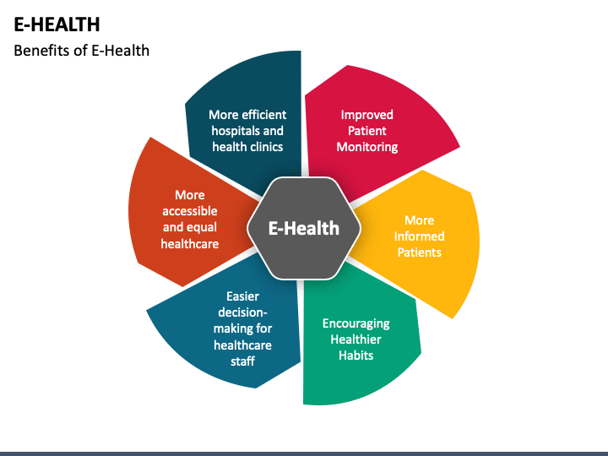
Benefits
4-<number>

Slide 44
E-education
E-education is using electronic or digital technologies to facilitate and enhance learning and education. It encompasses various educational activities and approaches that leverage digital tools and platforms to deliver, support, and enhance various aspects of the learning process.
4-<number>

Slide 45
Characteristics of E-education
Online Learning Platforms: Digital platforms that host educational content, courses, and interactive materials accessible via the internet.
Virtual Classrooms: Online environments that replicate traditional classrooms, allowing real-time interactions between students and instructors.
E-Learning Management Systems (LMS): Software applications that organize, deliver, and track educational content, assignments, and assessments.
Massive Open Online Courses (MOOCs): Large-scale online courses open to a global audience, often offered by universities and institutions.
4-<number>

Slide 46
Characteristics of E-education
Asynchronous Learning: Learning activities that don't require real-time interaction, enabling students to engage at their own pace.
Synchronous Learning: Real-time, interactive learning experiences where students and instructors engage simultaneously.
Digital Educational Resources: Digital textbooks, multimedia presentations, and online libraries supporting e-learning.
Adaptive Learning Systems: Personalized learning experiences tailored to individual student needs and progress.
4-<number>

Slide 47
Summary
We explored online shopping in E-commerce, how governments use tech for better public services in E-governance, and how digital tools are changing healthcare in E-Health.
Also, we saw how various online services impact our daily lives through Information and Communication Technologies (ICTs).
4-<number>

